Slide 1
Behavioral and Morphological Effects of Cannabidiol on Zebrafish
Isaac Shaw and Marcus Deknatel

Slide 2
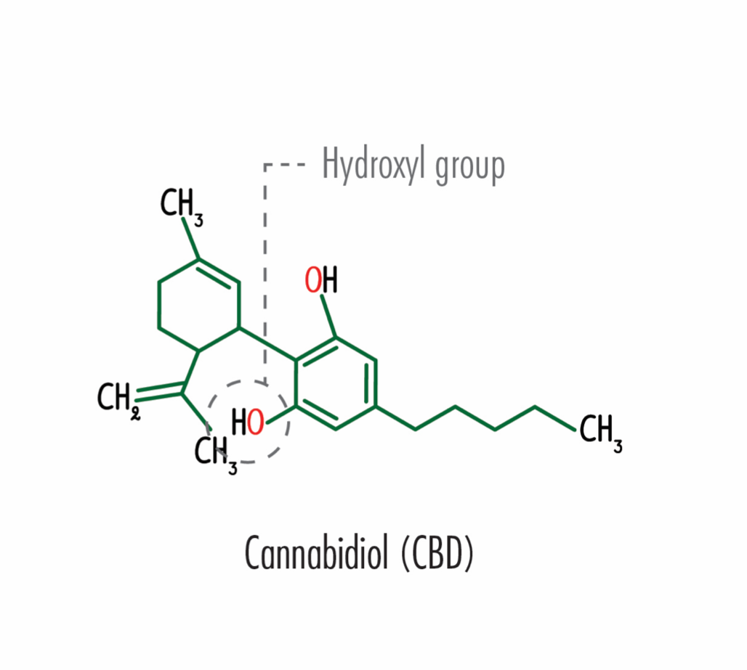
Cannabidiol
A primary active ingredient in both cannabis (marijuana) and hemp
Interacts with serotonin receptors and vanilloid receptors

Slide 3
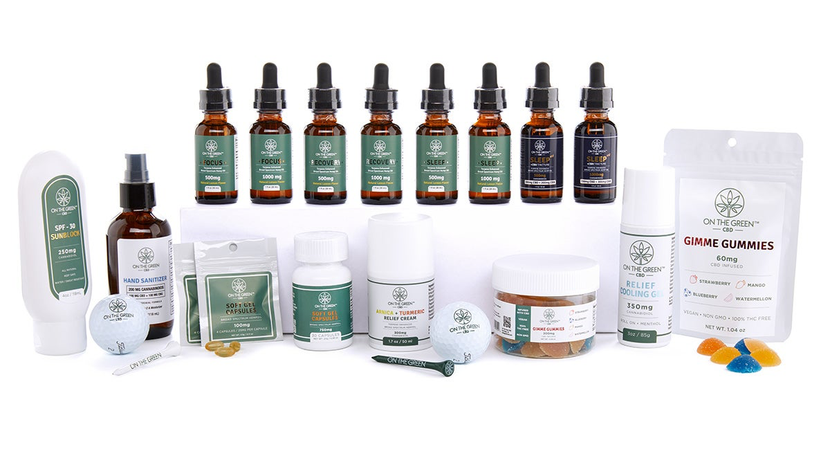
RELEVANCE OF CBD
Agricultural Improvement Act of 2018
Health benefits
Anxiety
Seizures
Pain relief (inflammatory & neuropathic)
Importance of research

Slide 4
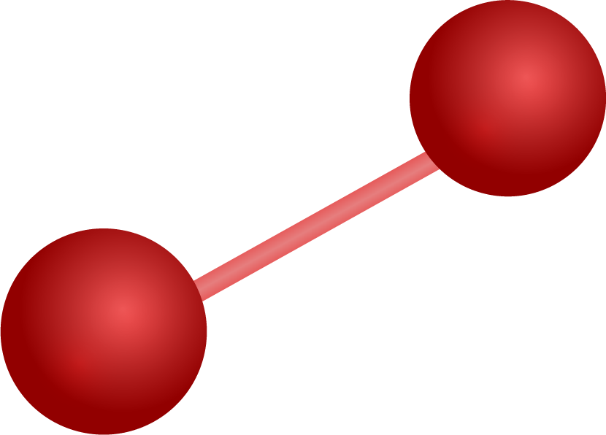
PREVIOUS RESEARCH
Developmental Effects of Cannabidiol and Δ9-Tetrahydrocannabinol in Zebrafish
Results
Impact
- Morphological
Yolk sac edema, Missing pectoral fins, Swim bladder distention
- Behavioral
Light response test
Concentrations < → Hyperlocomotion
- Comparison study
Notes:
Impact on our research:
Provides us with a comparison study. As I stated earlier there is not a large quantity of research on the impacts of CBD, thus, additional research allows for means to increase the accuracy and precision of the research
Furthermore, we were able to look at their methodology to help guide our decisions on what tests we would perform as well as some of the results associated with various concentrations

Slide 5
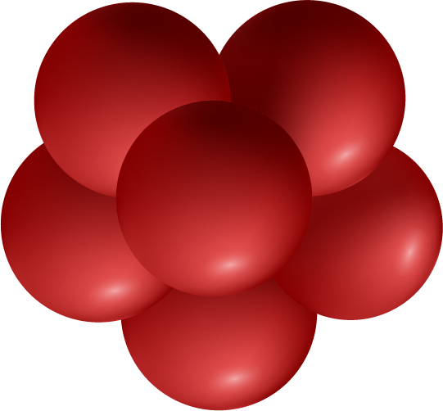
OUR STUDY
Goal
Testing
Experimental Design
Extrapolate further information on CBD’s effects on development
Performed identical tests to identify that which would impact development
Conducted two separate experiments to test differing conditions

Slide 6
OUR HYPOTHESES
We hypothesized that increasing morphological changes would occur in response to increasing concentrations of Cannabidiol.
We further hypothesized that during various behavioral response tests Cannabidiol would act as a stimulant at lower concentrations, and a depressant at higher concentrations.

Slide 7
EXPERIMENT TIMELINE
Keep Watch
Breed
Perform Tests
3
Nourish
1
5
Maintain Environment
4
2
6
Intoxicate Fish (For Science)
Reverse Reverse
7
Monitoring fish for deaths and malformations
Bred fish and divided them evenly into 6 wells removing debris
Light response, swirl, heart rate, touch
Feed fish at 6 and 9 dpf
Replace solution every two days
Adding the appropriate solution to each well and labeling it
Repeat 3-5 for 14 days

Slide 8
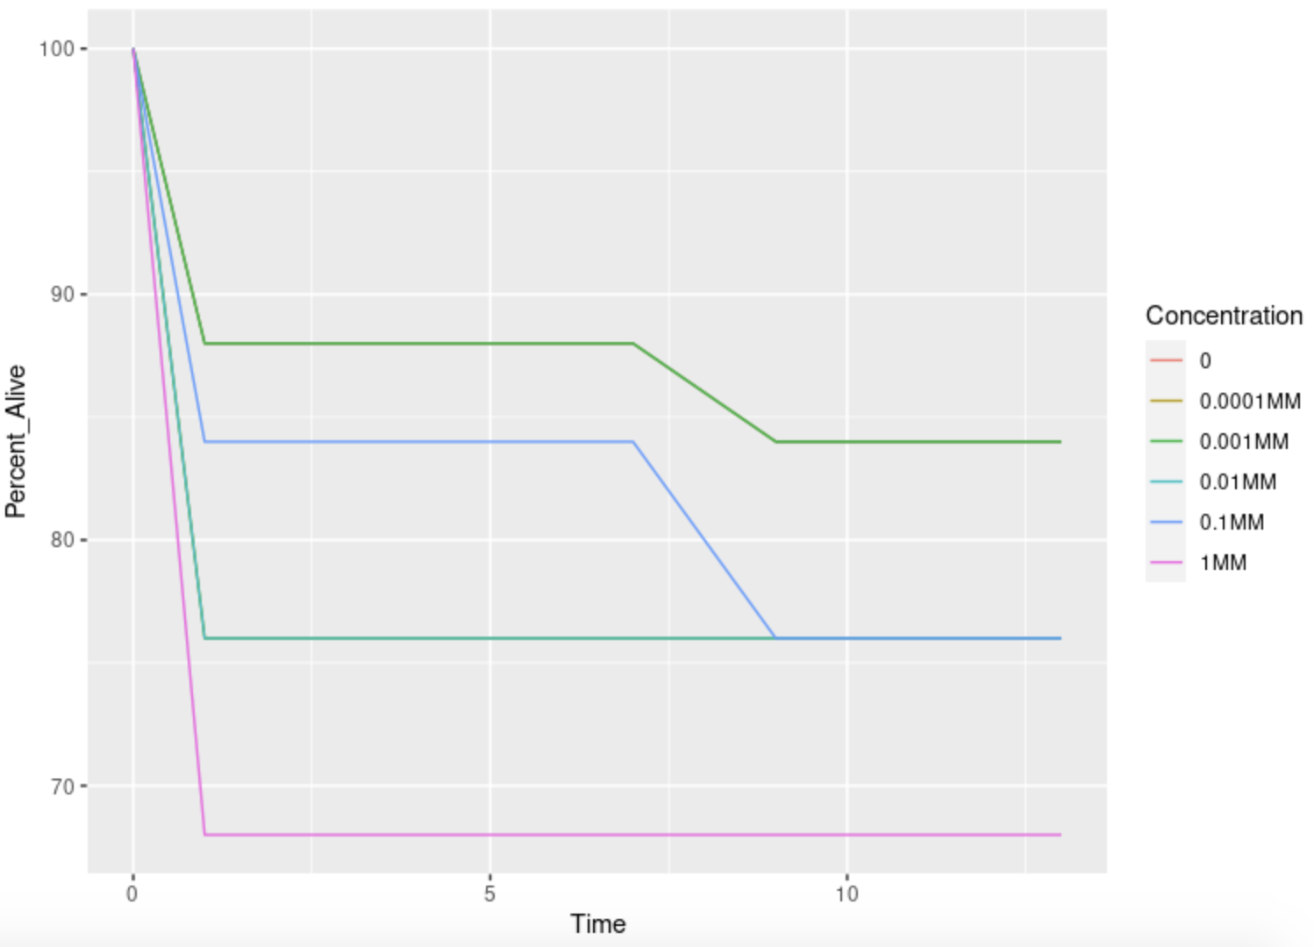
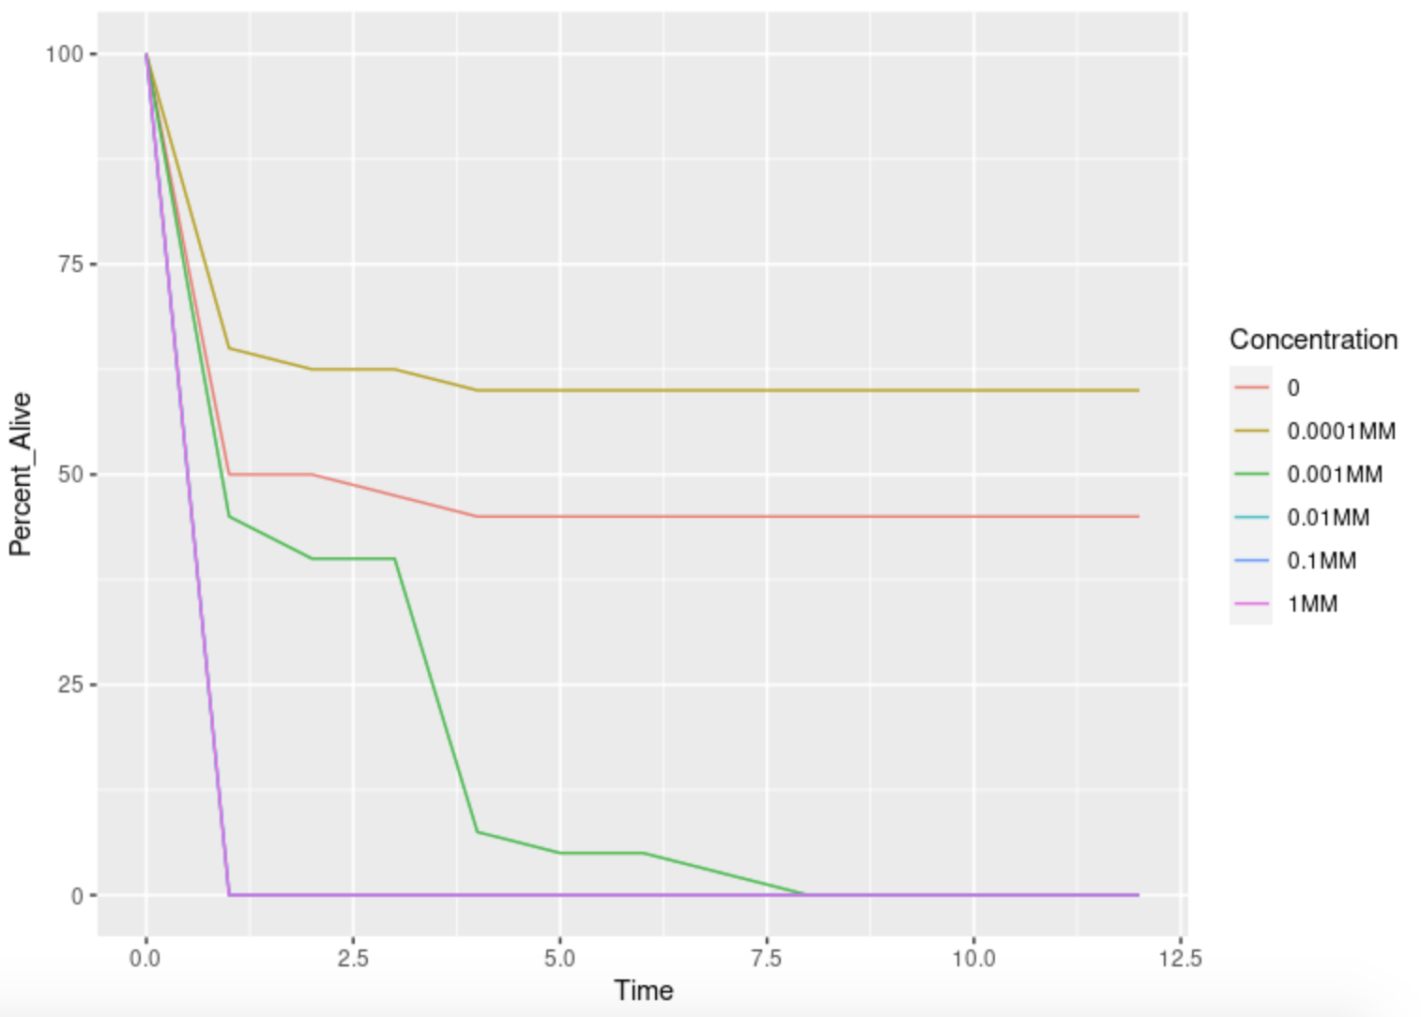
Mortality
EXPERIMENT A
EXPERIMENT B

Slide 9
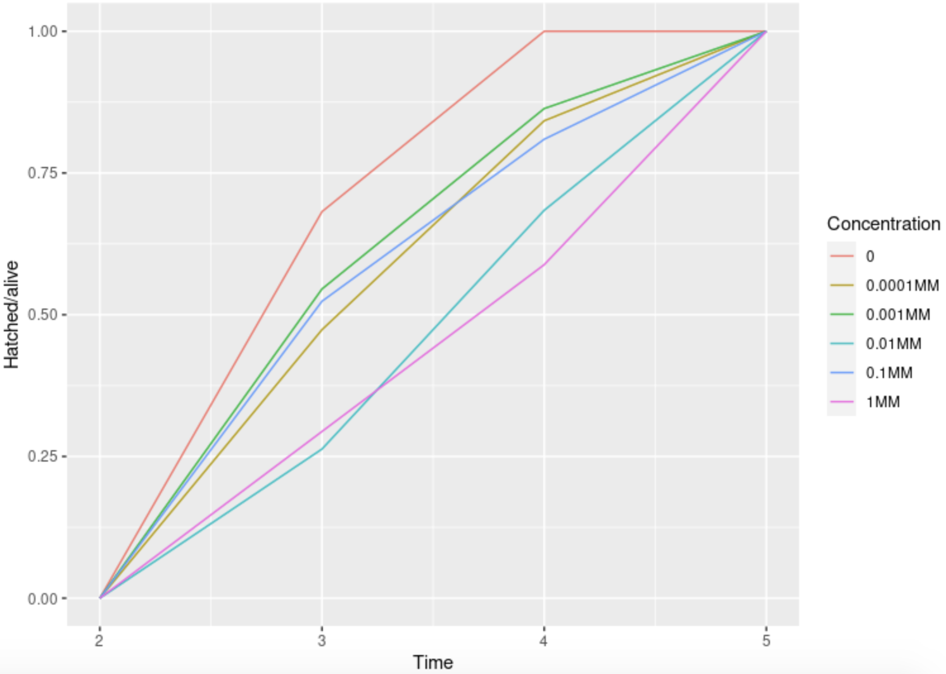
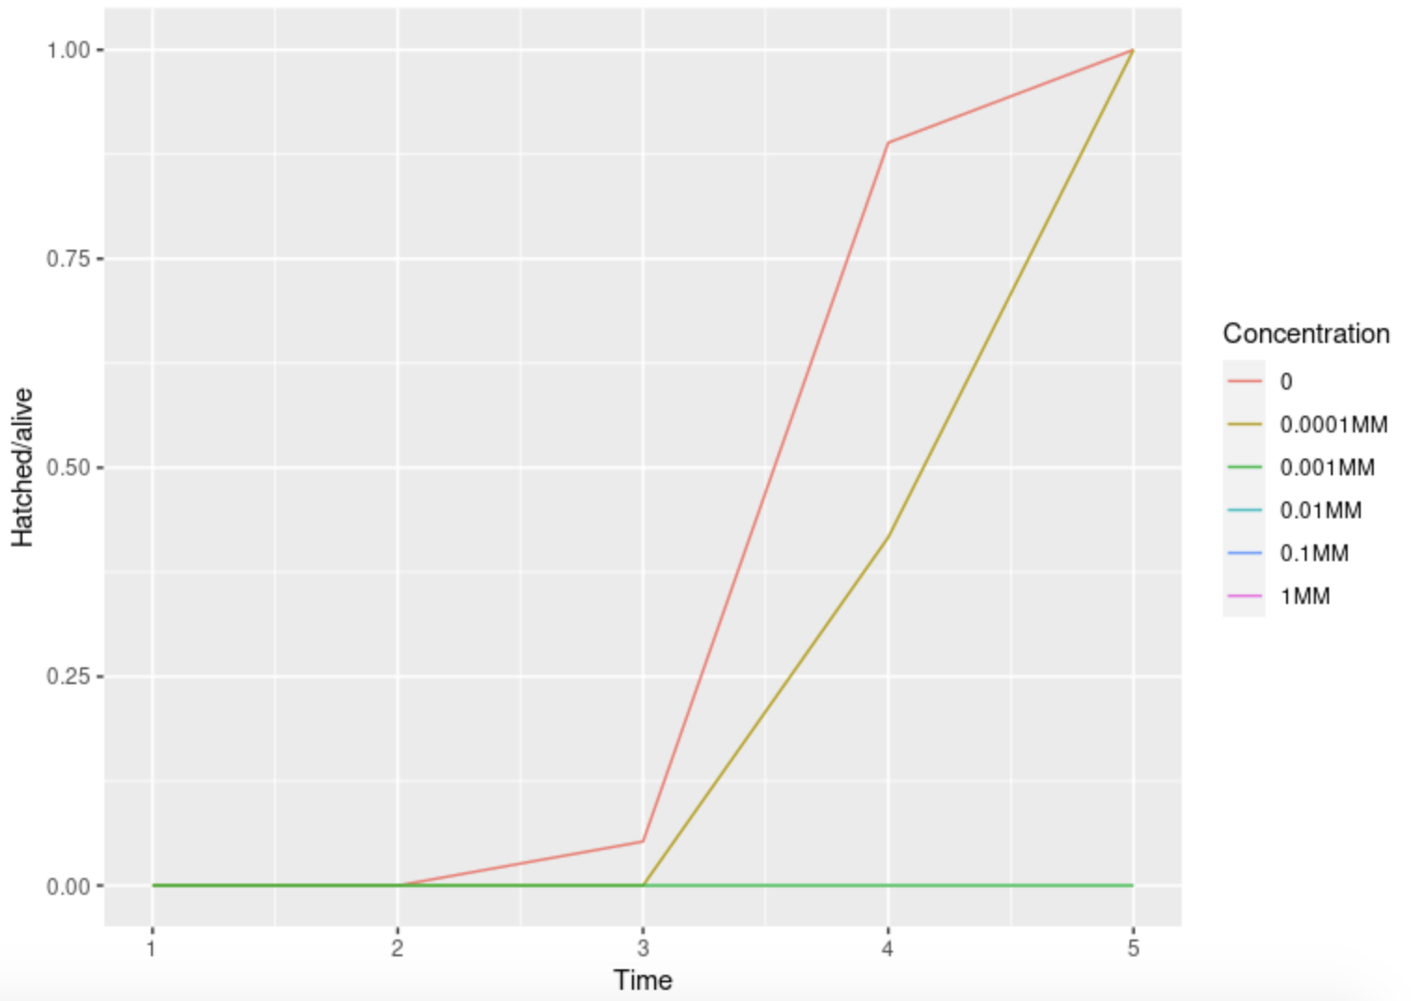
Hatch Rate
EXPERIMENT A
EXPERIMENT B

Slide 10
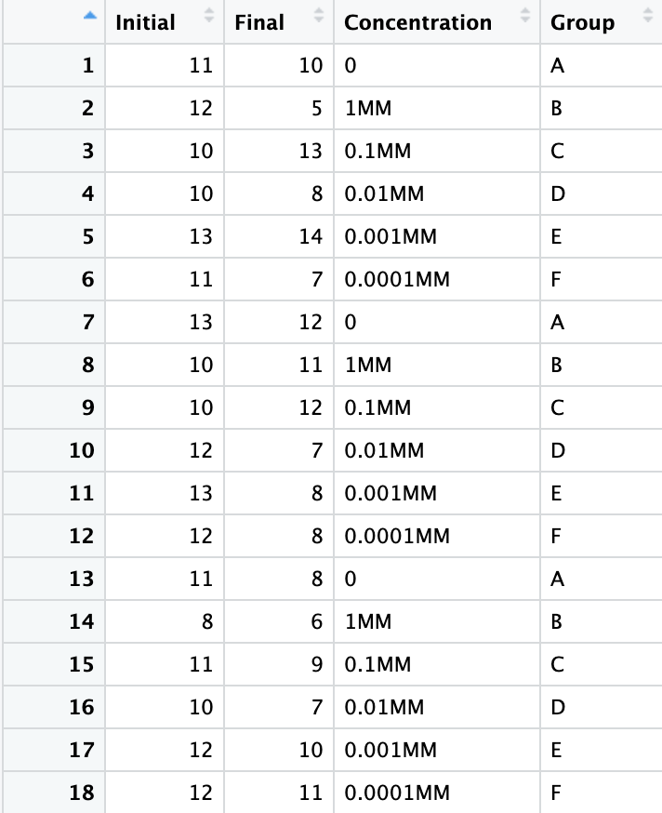
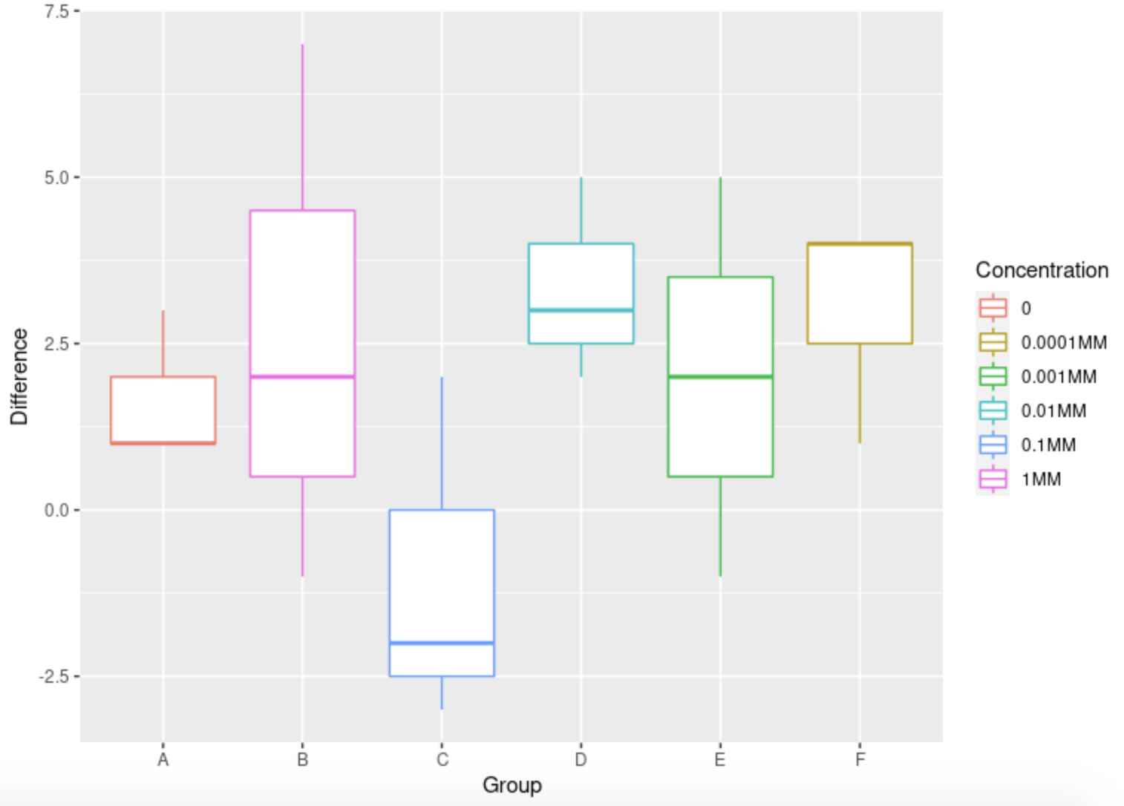
Light Response Test
EXPERIMENT TABLE
EXPERIMENT GRAPH

Slide 11
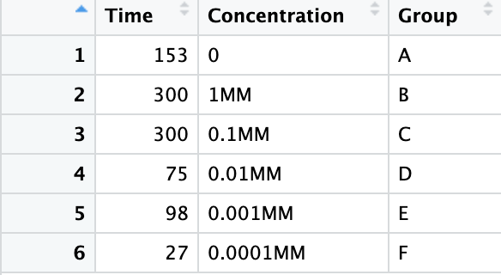
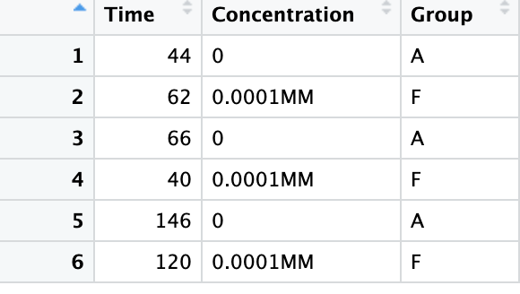
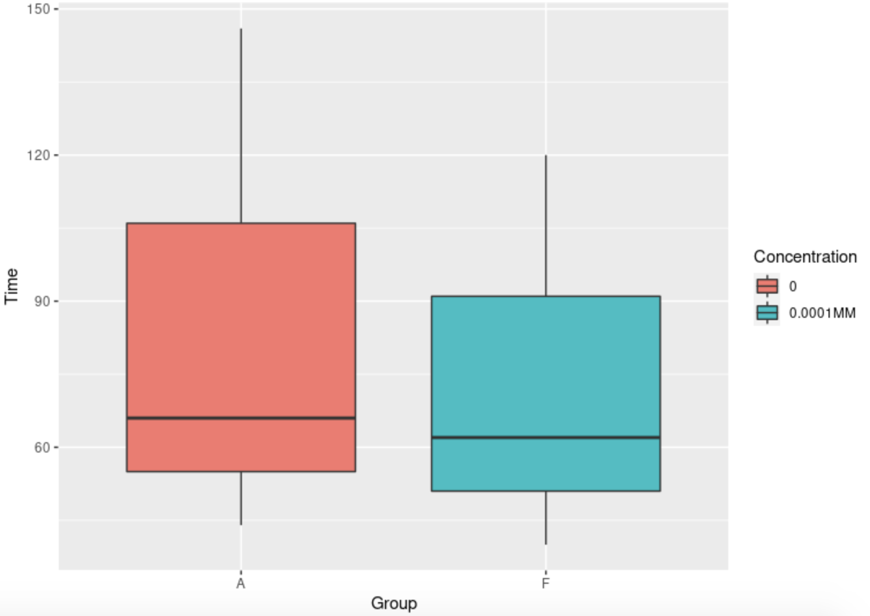
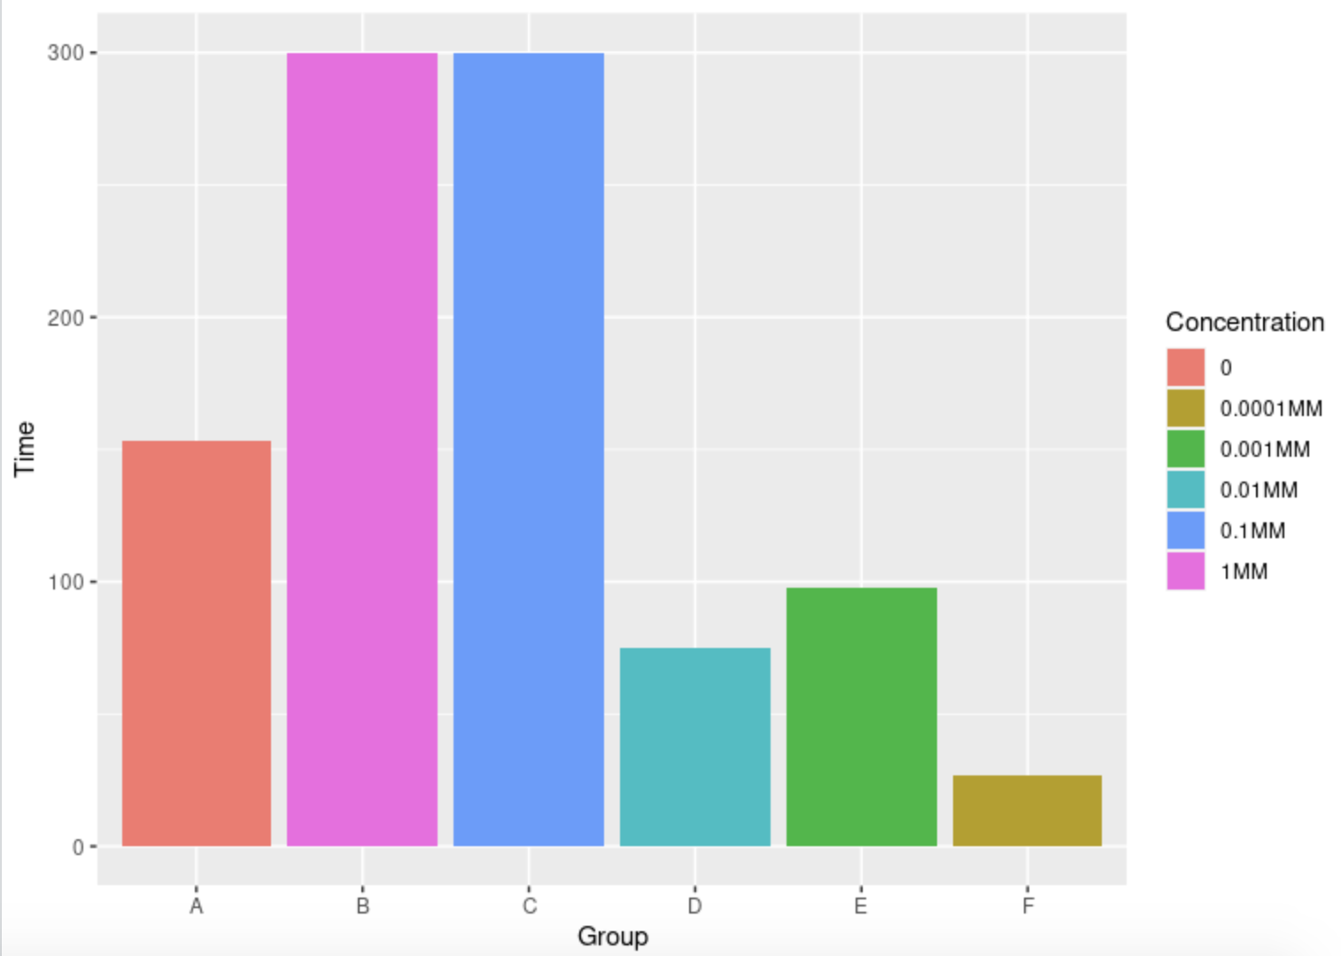
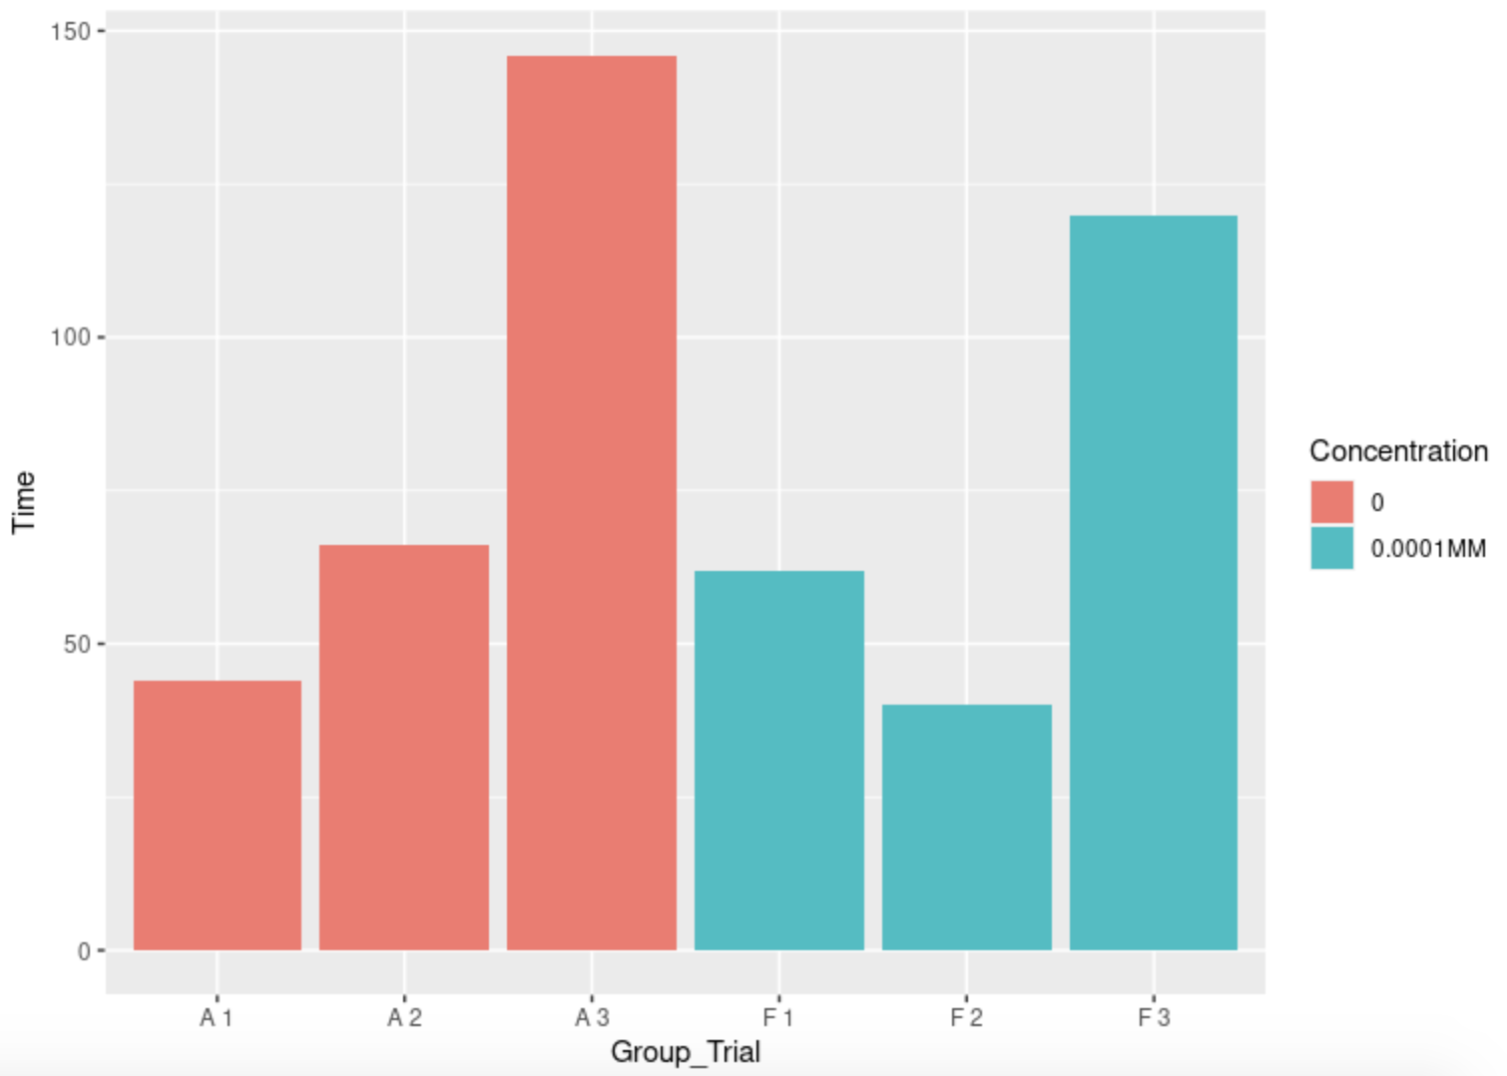
Swirl Test
EXPERIMENT A
EXPERIMENT B

Slide 12
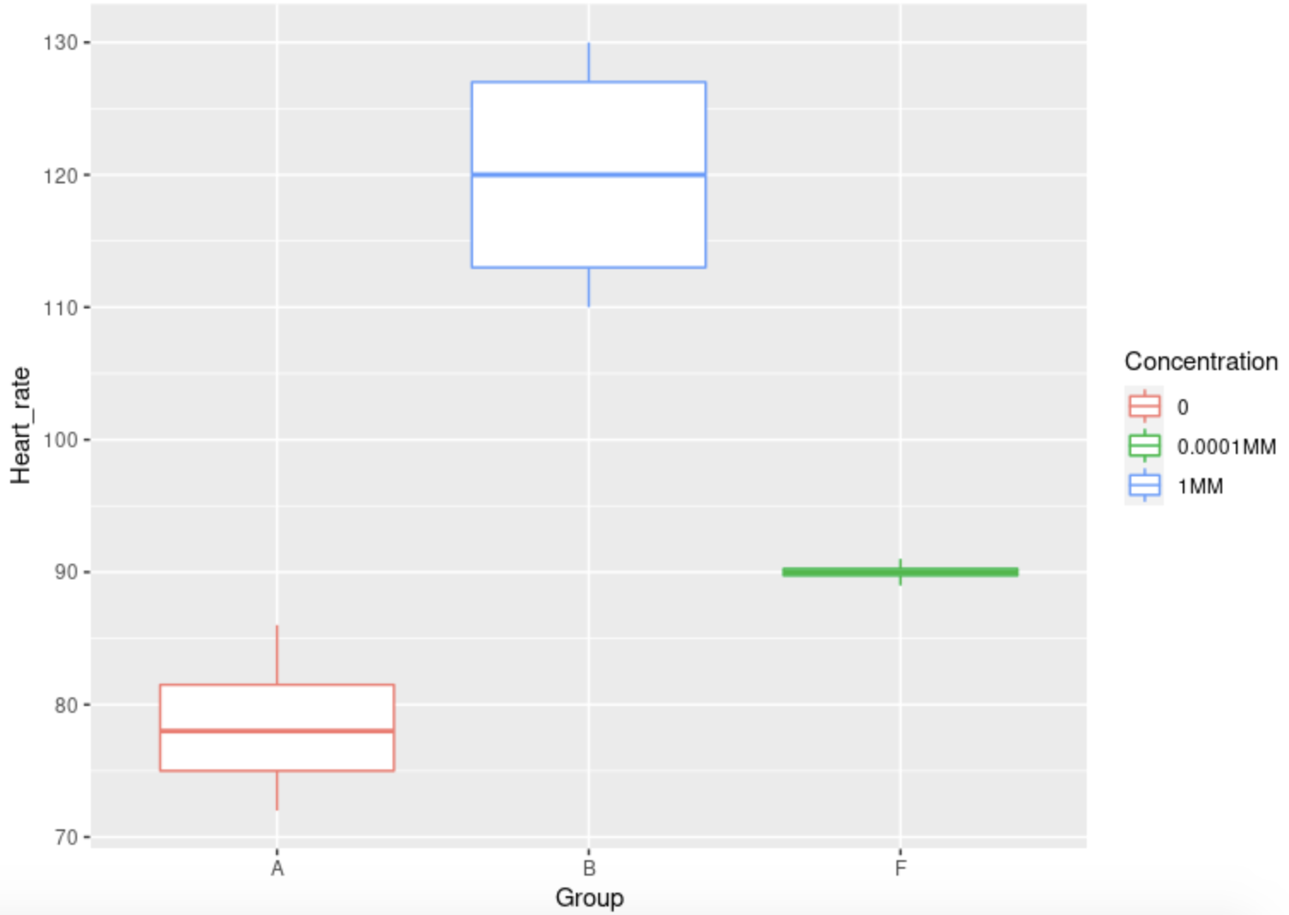
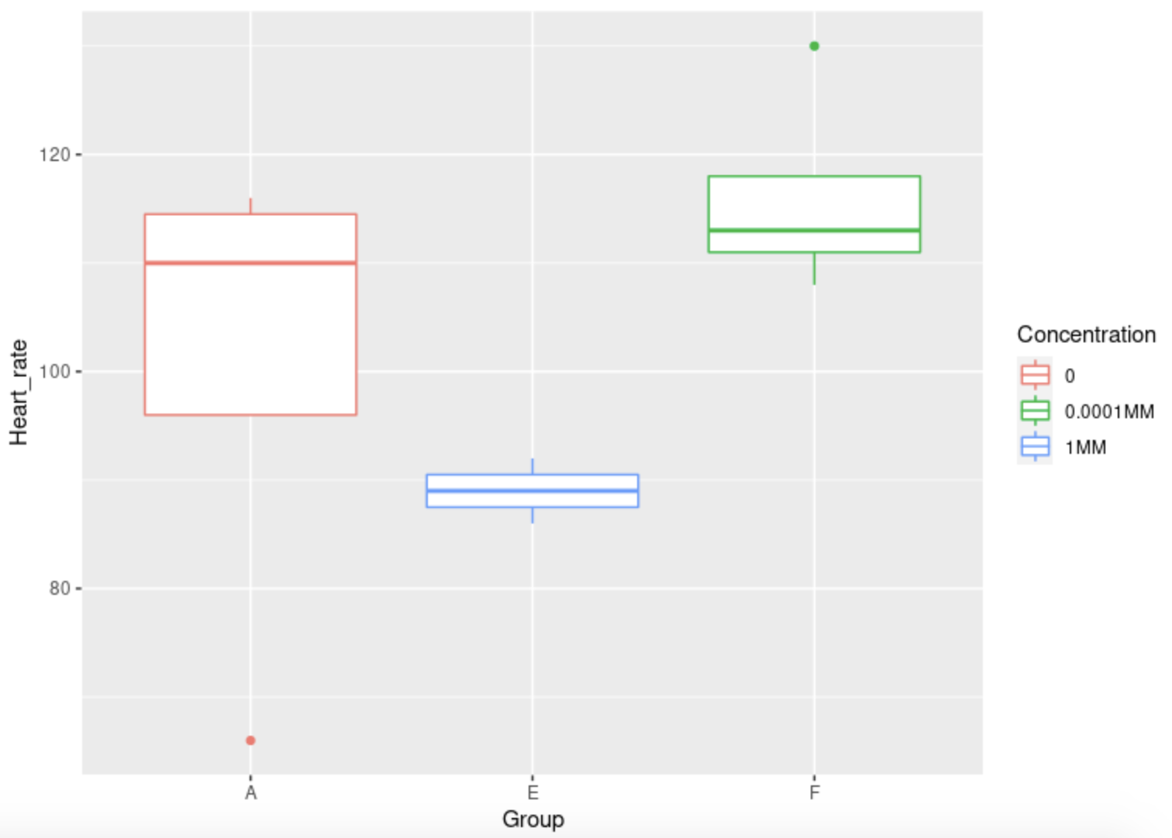
Heart Rate Test
EXPERIMENT A
EXPERIMENT B

Slide 13
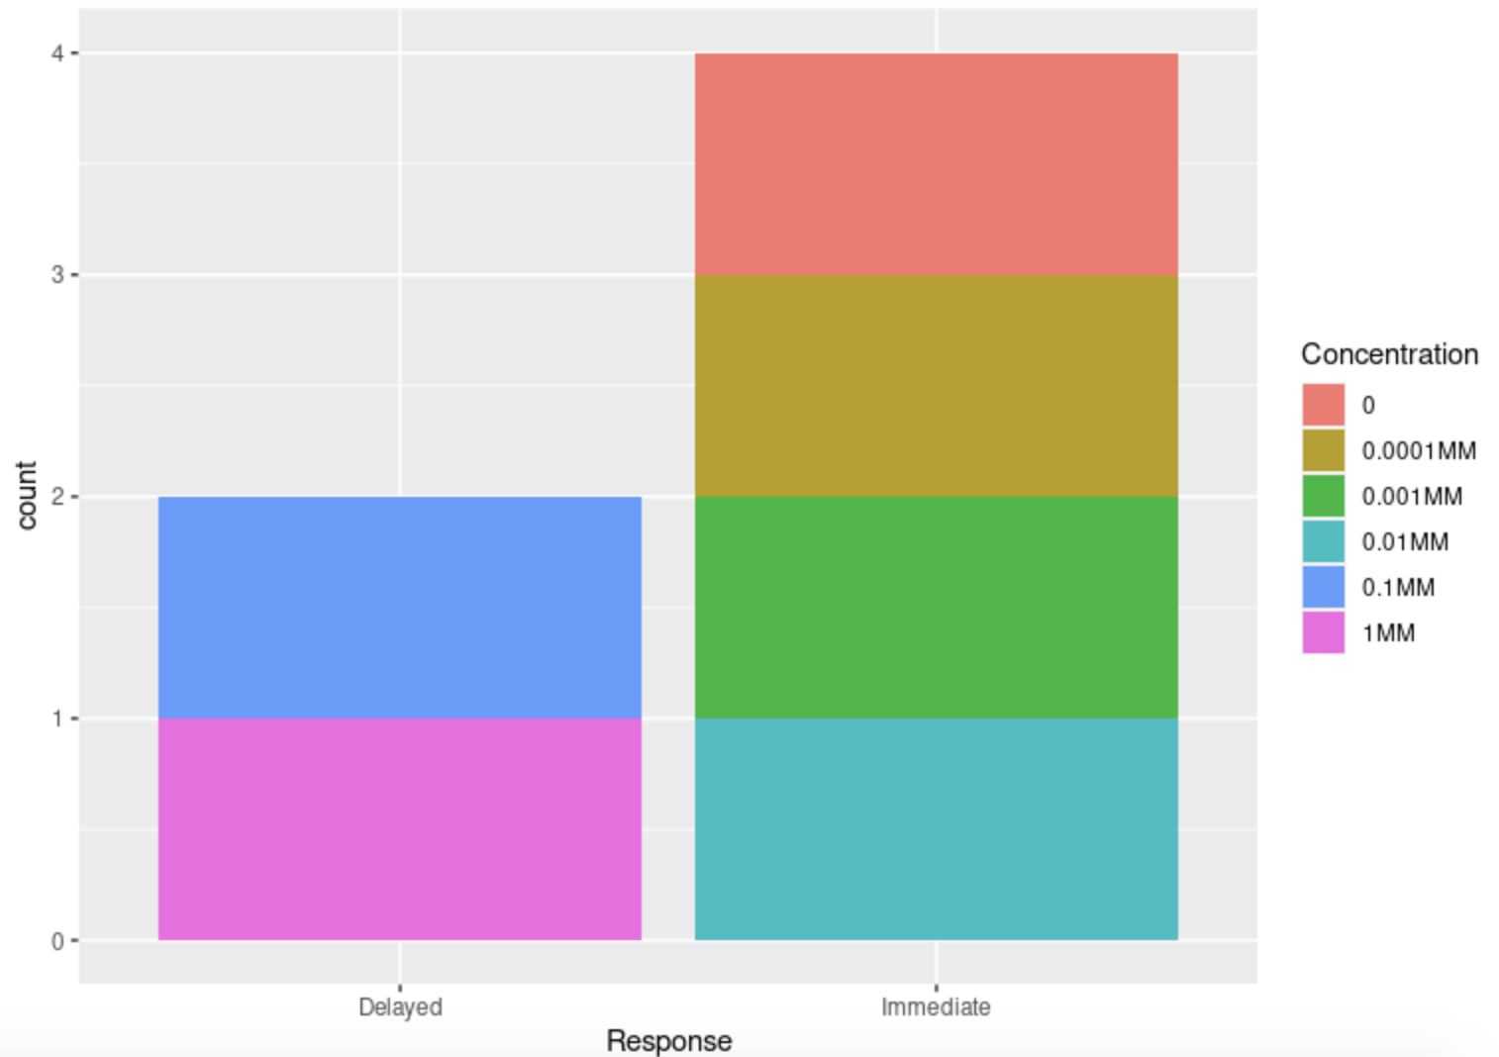
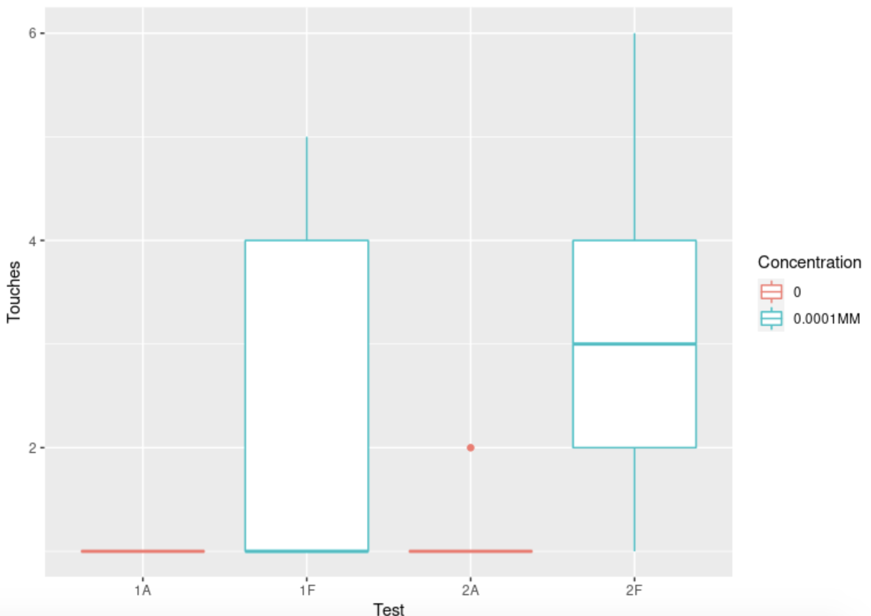
Touch Test
EXPERIMENT A
EXPERIMENT B

Slide 14
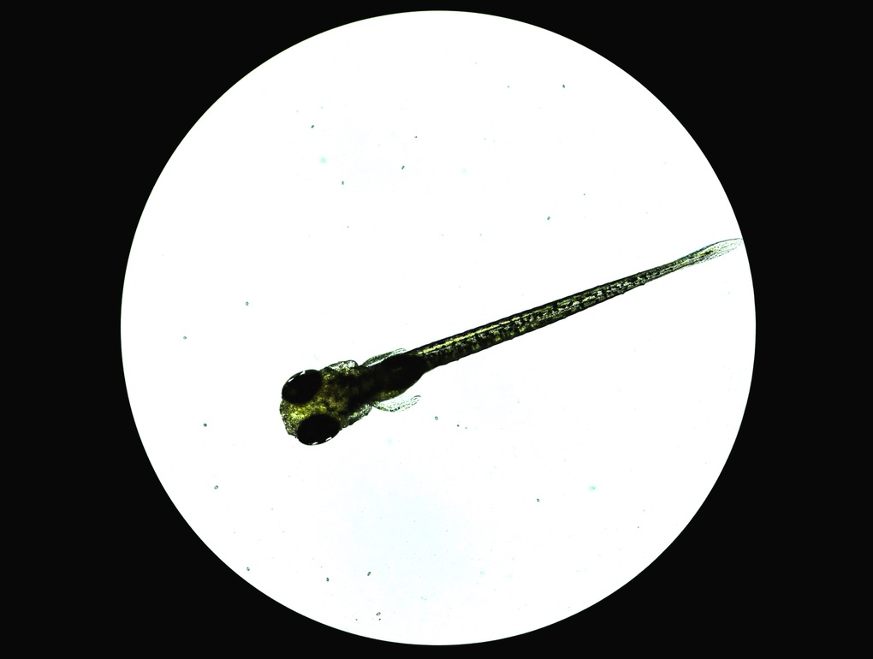
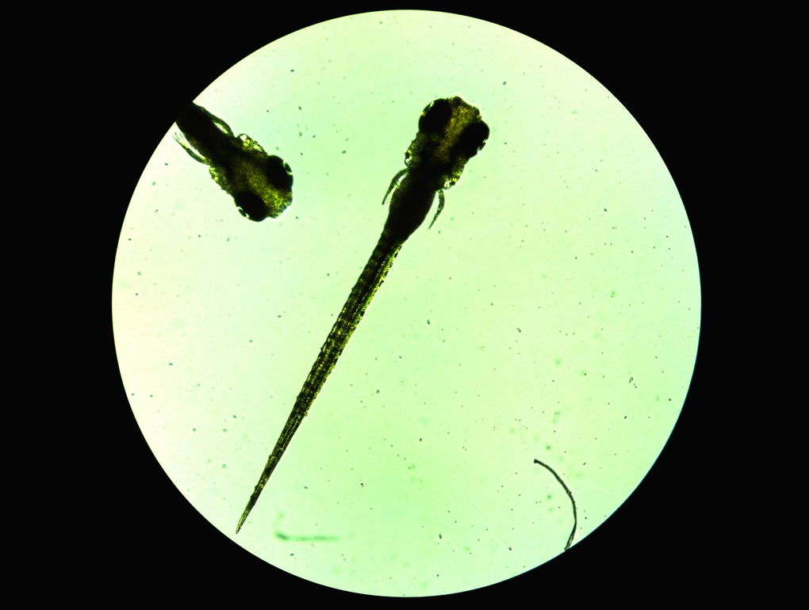
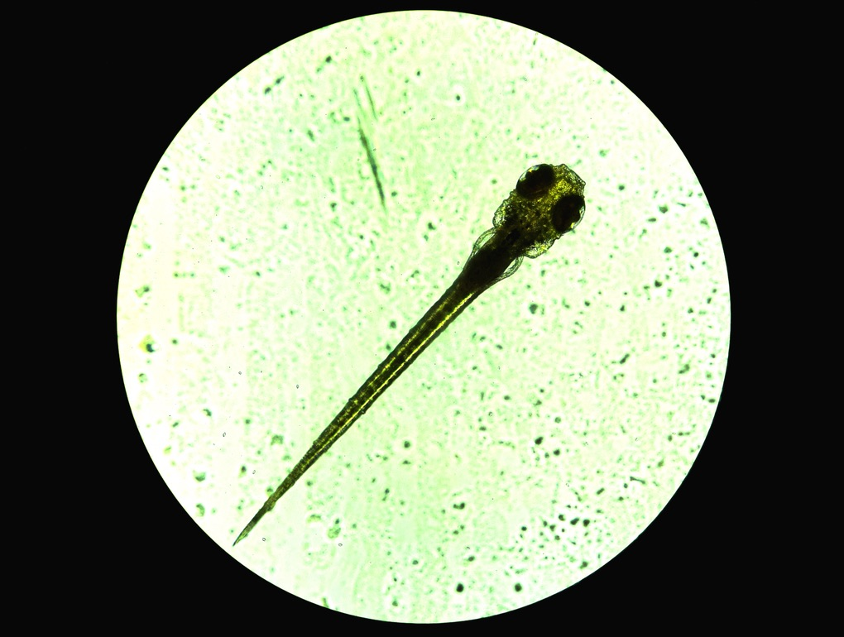
Morphological Findings
EXPERIMENT A
EXPERIMENT B

Slide 15
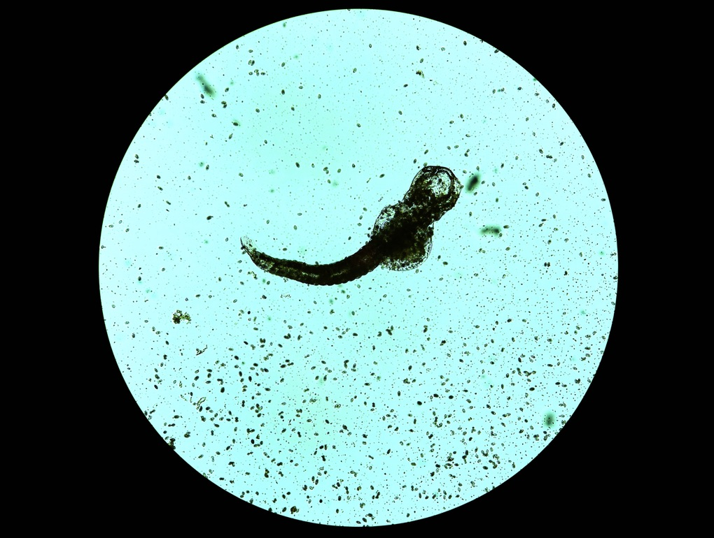
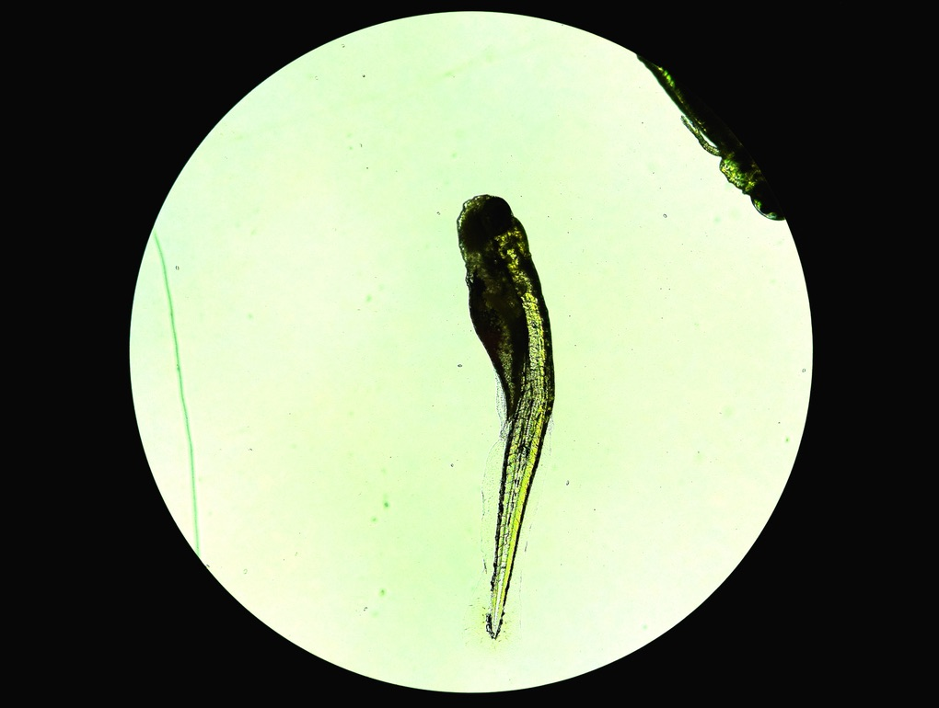
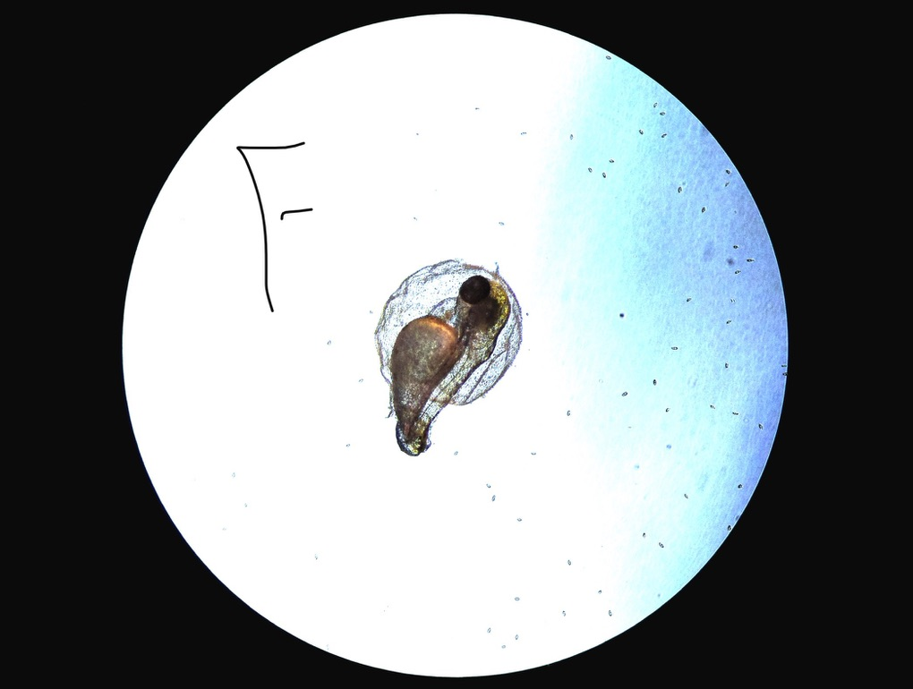
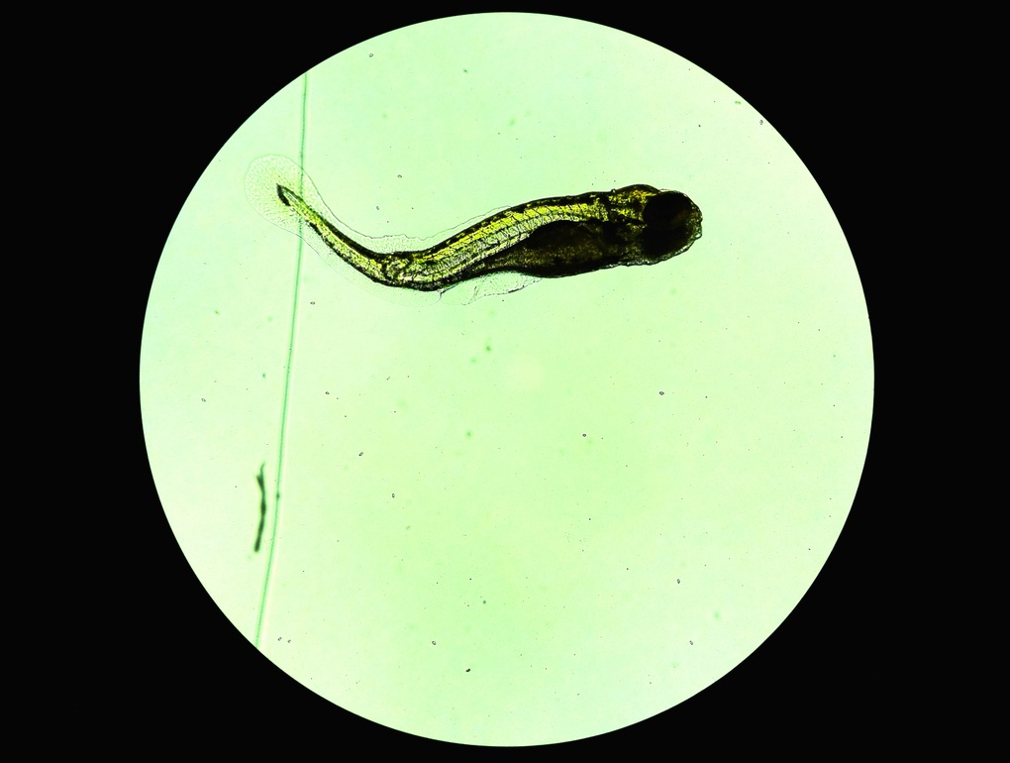
Morphological Findings
Cont.
EXPERIMENT B
F
F
B
F

Slide 16
CONCLUSIONS
Data supports:
Higher Concentrations increasing mortality
Slower hatch rate
Possible adverse reaction to light
A response to environmental stimuli has initial increase followed by a steep decrease
An increase in heart rate at higher concentrations
A decreased response to physical touch
A correlation to morphological defects

Slide 17
Acknowledgements
Thanks Dr. Coffield. You are a pretty cool dude.
Shout out to my homie nubb

Slide 18
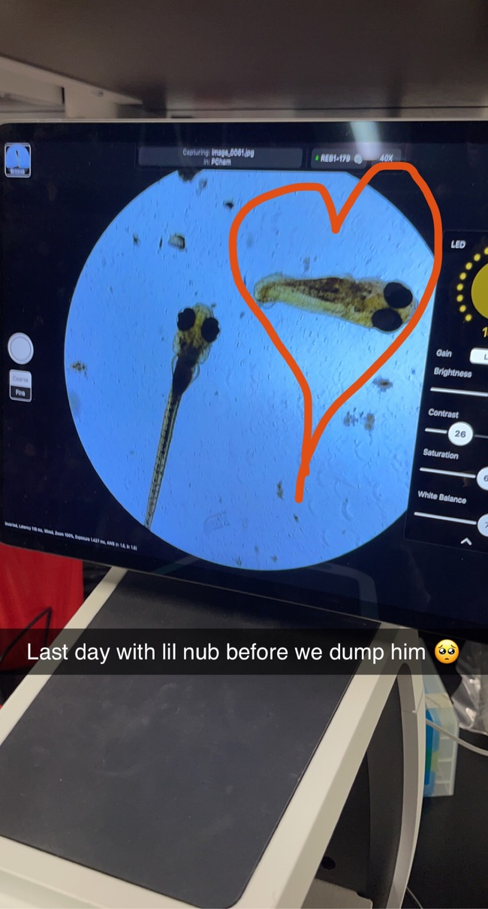
Moment of Silence For Nubb
May he forever RIP in peace
2021-2021

Slide 19
Fin
Gracias para su tiempo

